Slide 1
Mini Cache and Proxy Server
CSE-3111 Computer Networking Lab Course
Biplob Paul (50)
Mehedi Hasan (22)

Slide 2
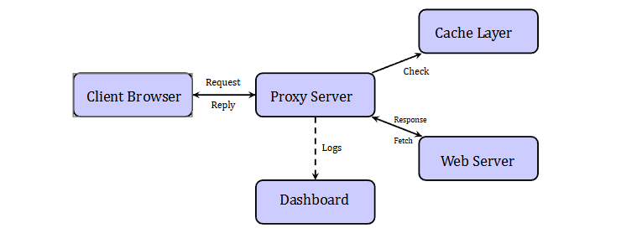
System Overview: How it works?
Client sends request to proxy Proxy checks cache first
If cached, return immediately
If not cached, fetch from web server Cache response and return
to client Log all activity to dashboard

Slide 3
Dashboard
Project starts with 2 different thread in port 9090 and 5000 in localhost.
Frontend fetch every req after 2 sec interval
Backend shows that in frontend for each log entry
config.json
Start
Dashboard Shows:
- Live request table
- Cache statistics
- Blacklist status
- Cached URLs list
- Test interface
Proxy Server at 127.0.0.1:9090
Log Dashboard at 127.0.0.1:5000

Slide 4
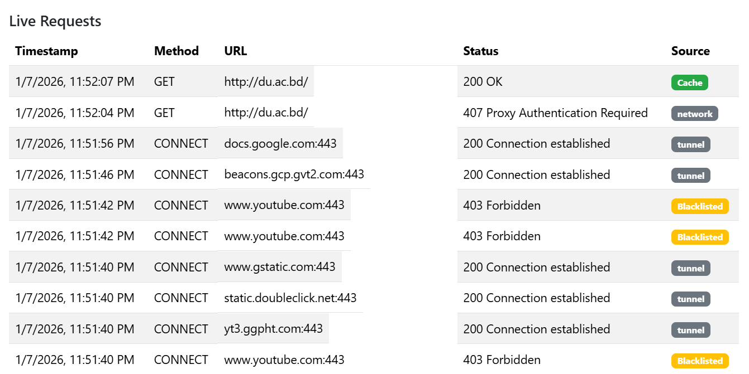
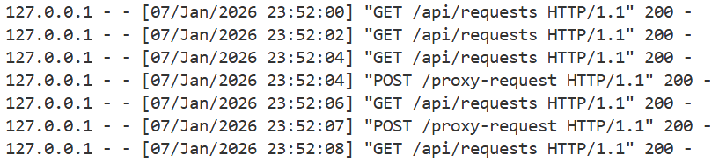
@app . route (’/ api/ requests ’)
def get_requests (): return jsonify (
request_log . get_all ()
)
# Each request logged : log_entry = {
" timestamp ": "...",
" method ": " GET", " url": "...",
" status": " 200 ",
" source ": " cache "
}
request_log . add ( log_entry )

Slide 5
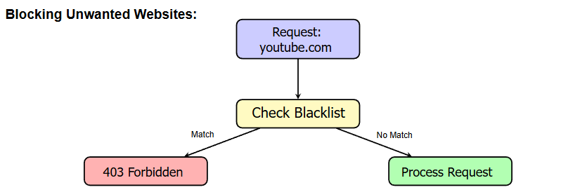
How Domain blocking works?
def is_blacklisted ( url):
domain = extract_domain ( url)
for blocked_domain in blacklist:
if domain == blocked_domain or domain. endswith ("." + blocked_domain ):
return True return False
# In request handler
if is_blacklisted ( url):
return " HTTP /1.1 403 Forbidden "

Slide 6
How caching works?
We have mainly implemented LRU and Memory Cache here.
LRU (Least Recently Used) deletes the least used cache when memory becomes full.
Memory cache stores data in dictionary while running this python program.
Is it stores data on memory in OS Level? No
❌ Laptop cache memory
❌ CPU L1/L2/L3 cache
❌ OS page cache
❌ Browser cache
❌ Disk cache

Slide 7
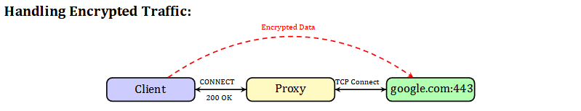
How http tunneling works
Client: ”CONNECT www.google.com:443”
Proxy establishes TCP connection to Google
Proxy replies: ”200 Connection established”
Client performs TLS handshake directly with Google
Proxy forwards encrypted data bidirectionally
Proxy cannot see content (end-to-end encryption)

Slide 8
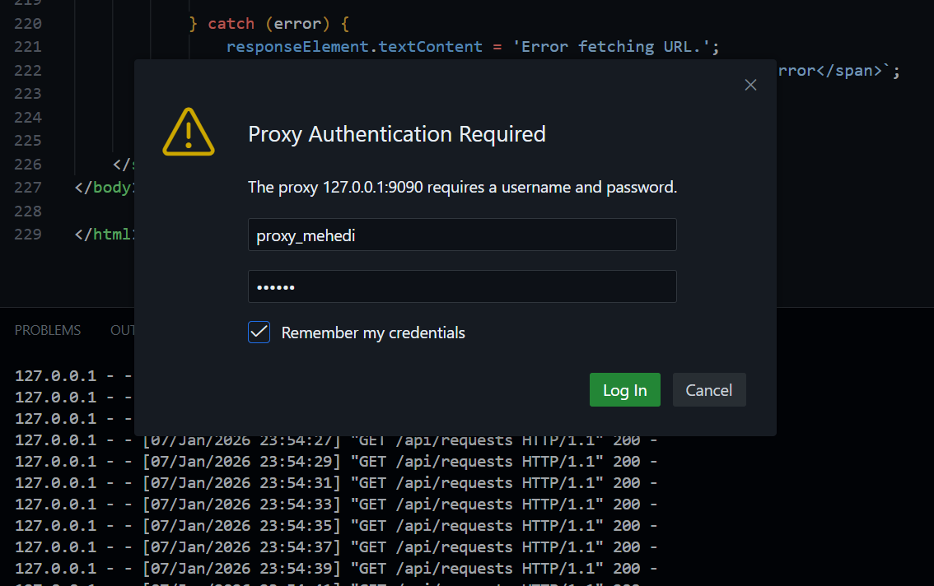
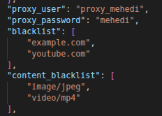
Proxy authentication and Domain & Content Blocking

Slide 9
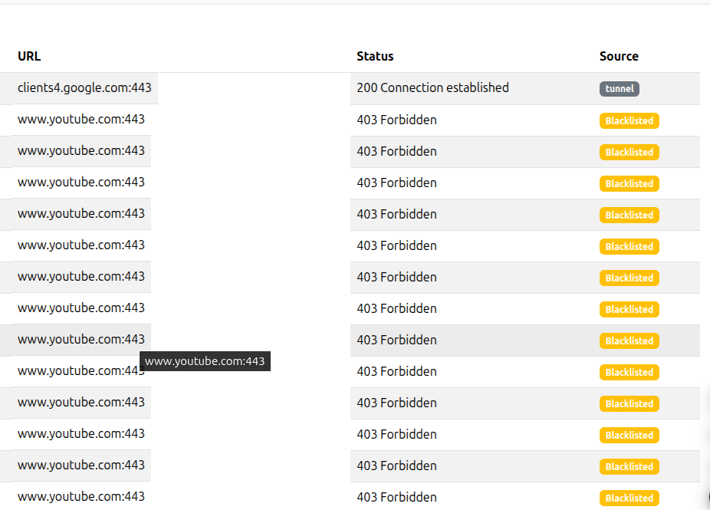
Some screenshots of the Dashboard

Slide 10
THANK YOU

